Slide 1
cs50 section 8
Web
Andrew Holmes 2023

Slide 2
Today’s plan
HTML
03
JavaScript
01
02
CSS
04
PSET
The building blocks
La casa Madrigal
A little polish
Ball’s in your court!

Slide 3
01
HTML
The building blocks

Slide 4
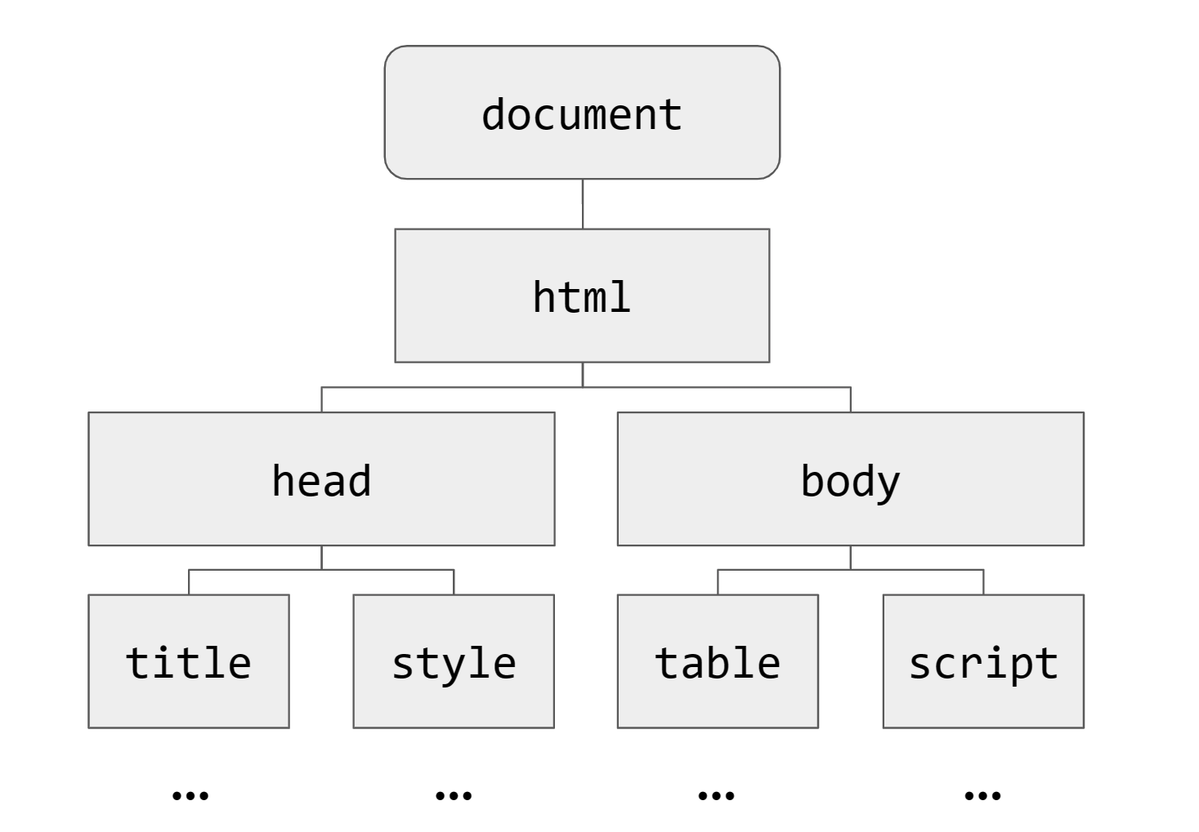
Document Object Model (DOM)
HTML
scoreboard.html from week 8 code.
Document is a tree structure

Slide 5
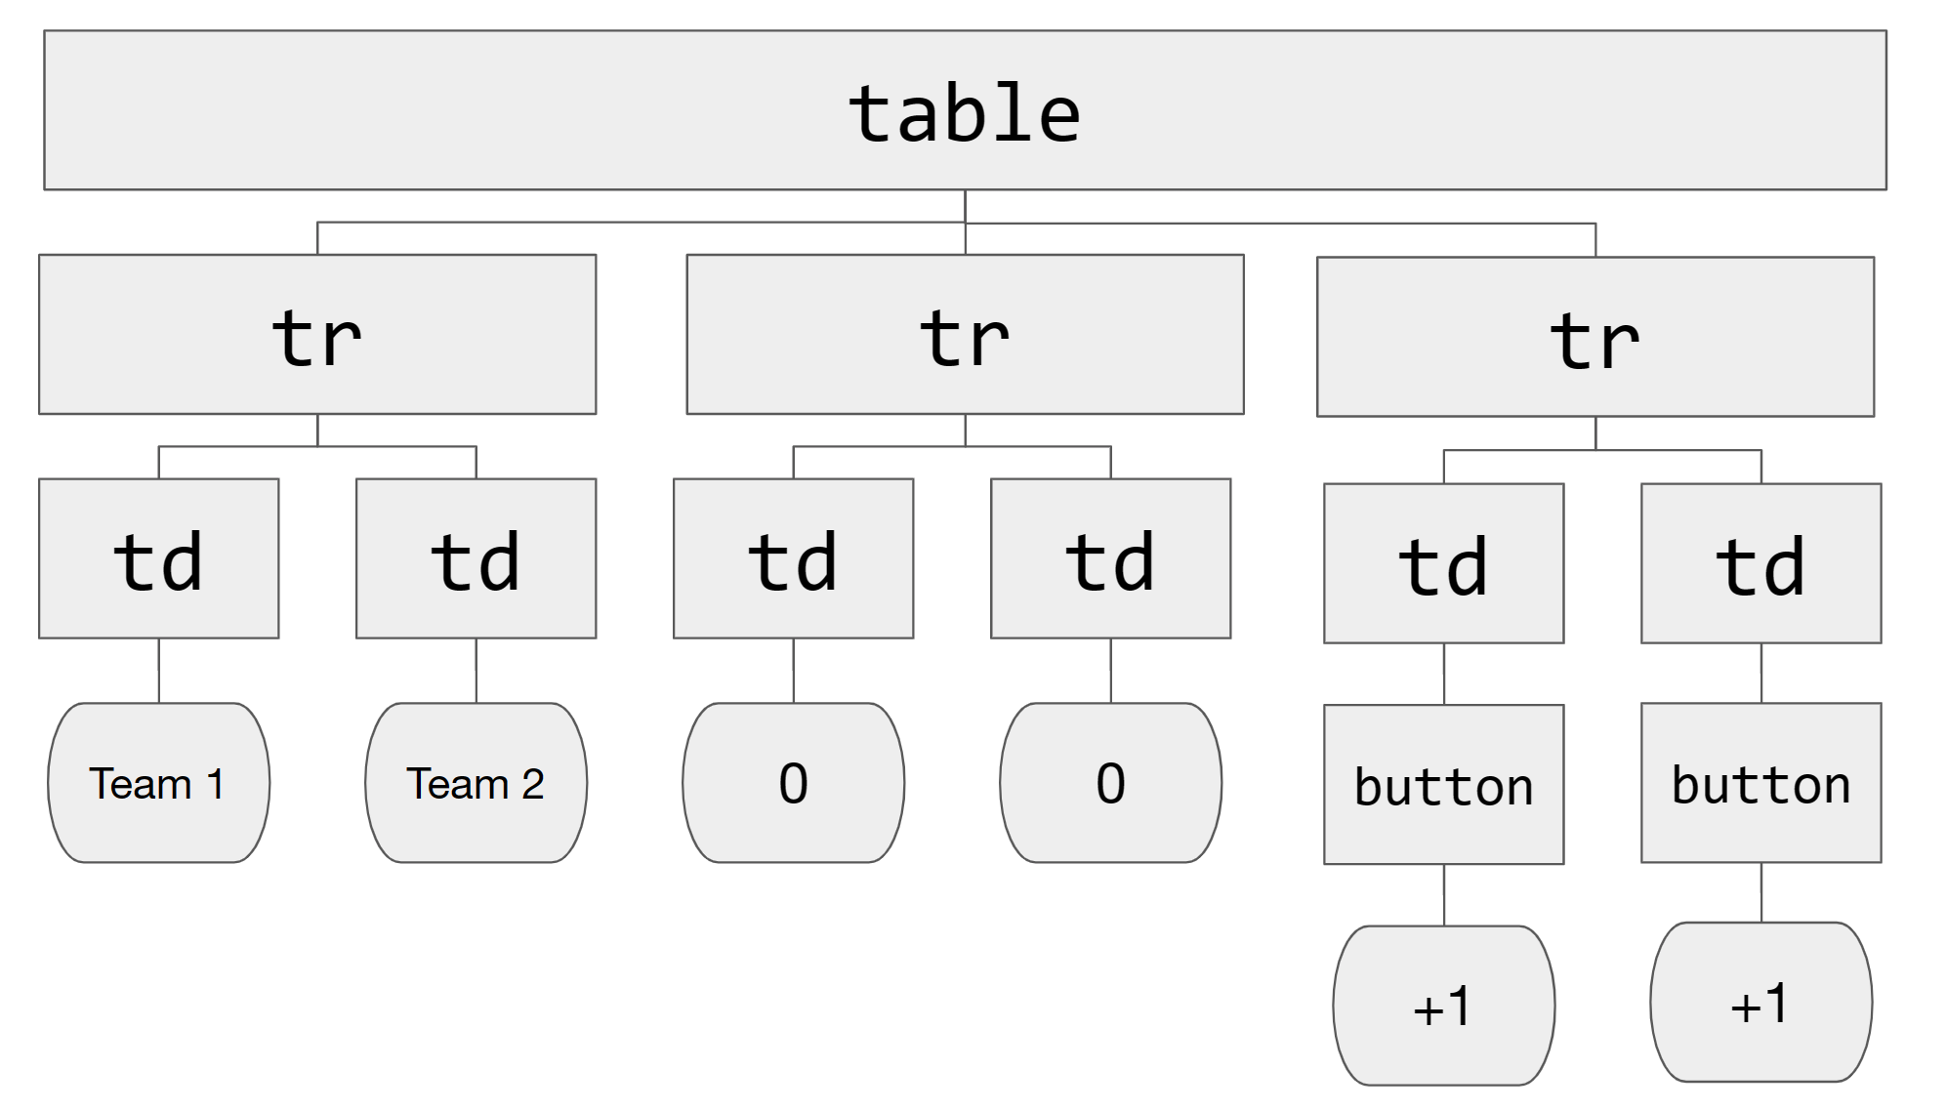
Document Object Model (DOM)
HTML

Slide 6
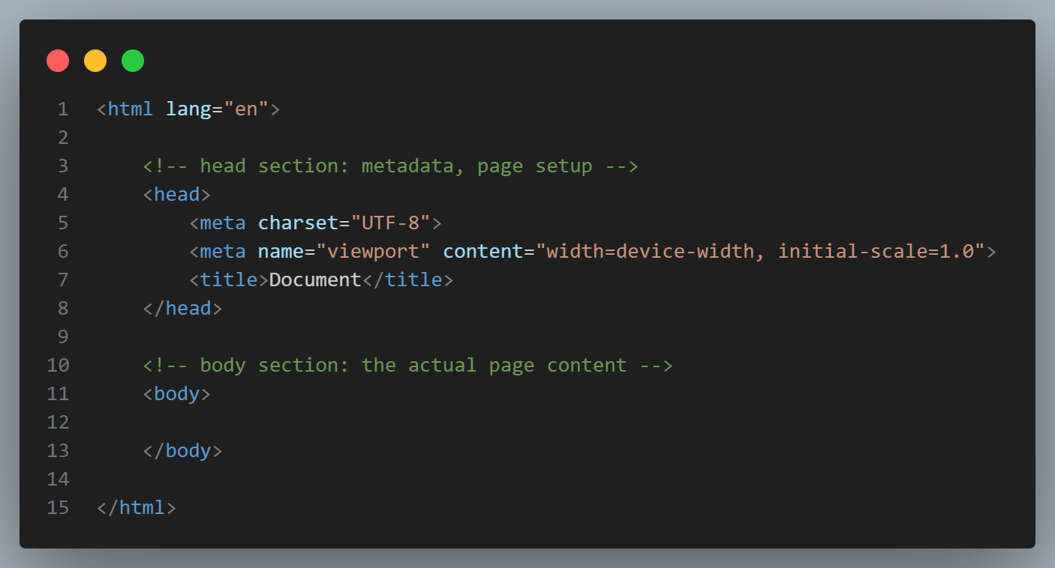
HTML
HTML

Slide 7
HTML tags
HTML
Tags (almost) always appear in pairs:
<opentag>
content
</closetag>
Can you think of a tag that doesn’t need closing?
one example: <link>

Slide 8

HTML attributes
HTML
You can modiy tags using attributes
<p style=“color:blue”>
hi!
</p>

Slide 9
A million possibilities
HTML
There’s loads of tags, here are some of the most common:
<div>, <p>, <img>, <link>, <hr>, <br>, <head>, <body>, <h1/2/3>, <header>, <section>, <span>, <ul>, <ol>, <li>, <a> and many more

Slide 10
And a million more
HTML
And even more attributes. Here’s some key ones:
id class style
href src onclick

Slide 11
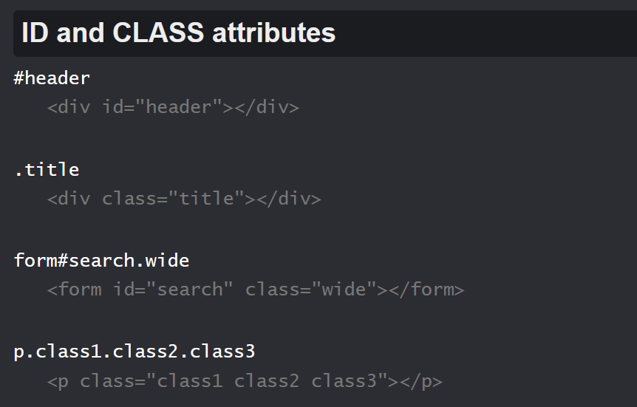
Writing HTML fast
HTML
Emmet is a tool to write HTML faster!
It has a pretty great cheatsheet…
Notes:
Cheat Sheet (emmet.io)

Slide 12
HTML example
Experimenting with some tags/attributes

Slide 13
02
CSS
Making it pretty

Slide 14
Cascading Style Sheets
CSS
selector
{
property: value;
property: value;
}

Slide 15
Cascading Style Sheets
CSS
p
{
background-color: blue;
color: white;
}

Slide 16
Cascading Style Sheets
CSS
<style>
p
{
background-color: blue;
color: white;
}
</style>

Slide 17
Cascading Style Sheets
We aim to keep these separate – tweaking form should never risk damaging function, easier to manage code.
CSS
Generally we avoid inline style:
<p style=“…”> </p>
<style> … </style>
Function
HTML
Form
CSS

Slide 18
Cascading Style Sheets
CSS
To use a CSS file, we use link:
<link rel=“stylesheet”
href=“styles.css”>

Slide 19
Why cascading style sheets?
CSS
background-color: blue;
Lower elements by default ‘inherit’ style. A change cascades down the tree.

Slide 20
Previous example
CSS
p
{
background-color: blue;
color: white;
}
Currently affects all paragraphs!

Slide 21
Let’s spice it up
CSS
In index.html :
<p id=“special-p”>
In styles.css:
#special-p {
background-color: red;
}

Slide 22
Fighting the waterfall
CSS
We have this CSS, what color is the paragraph?
#special-p {
background-color: red;
}
p {
background-color: blue;
}

Slide 23
Classes vs ids
CSS
<div class=“home-item theme-1”
id=“about-section”> … </div>
id should be unique, to give a specific element unique styling.
Classes can be re-used, and elements can (and often) have multiple classes.

Slide 24
Classes vs ids
CSS
<div class=“home-item theme-1”
id=“about-section”> … </div>
.home-item { … }
#about-section { … }

Slide 25
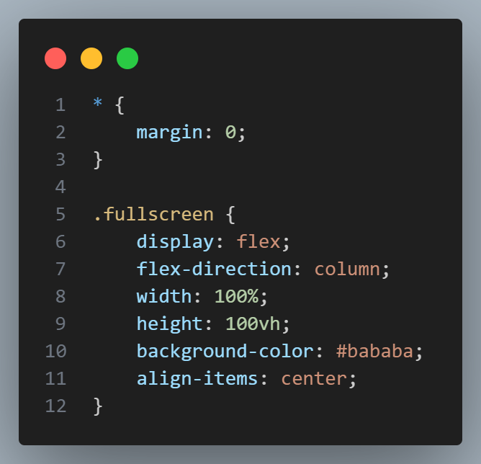
CSS example
CSS
Here’s an example of some CSS I wrote for the intro slide. * modifies all elements like in SQL.
Then I have some code that only affects objects in the ‘fullscreen’ class.

Slide 26
CSS variables
CSS
Good design practice is to use CSS variables to organize themes etc.
:root {
--main-color: #e3e3e3;
}
CSS allows custom attributes by starting with --

Slide 27
CSS variables
CSS
:root {
--main-color: #e3e3e3;
}
p {
background-color: var(--main-color);
}

Slide 28
CSS variables
CSS
:root is a pseudo-element. These are a
little odd, but sometimes useful
e.g.
button:hover {
background-color: black;
}

Slide 29
Common CSS selectors
CSS
display color padding margin
height width border font-weight
display text-align flex
position outline
and many more!

Slide 30
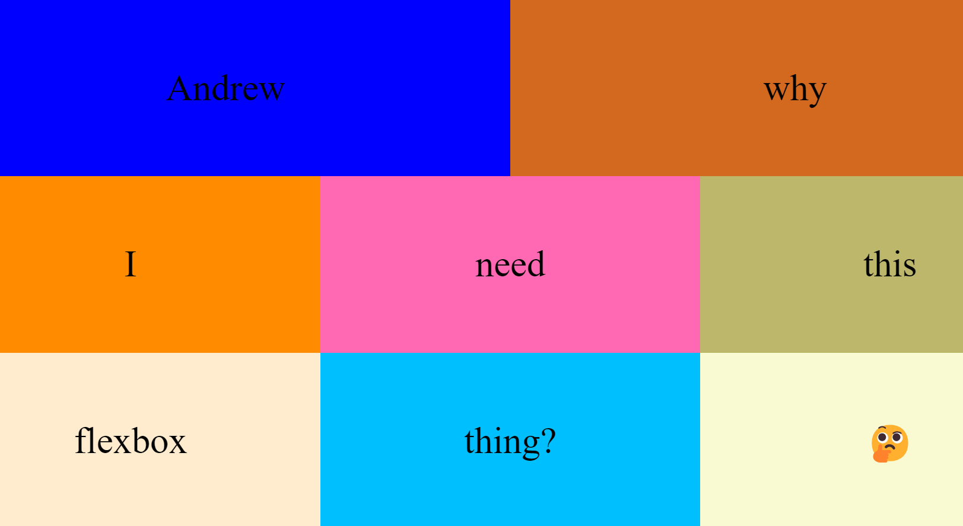
Flexbox
CSS

Slide 31
Flexbox
CSS
The secret sauce!
.container {
display: flex;
flex-direction: column;
align-items: center;
justify-content: center;
}

Slide 32
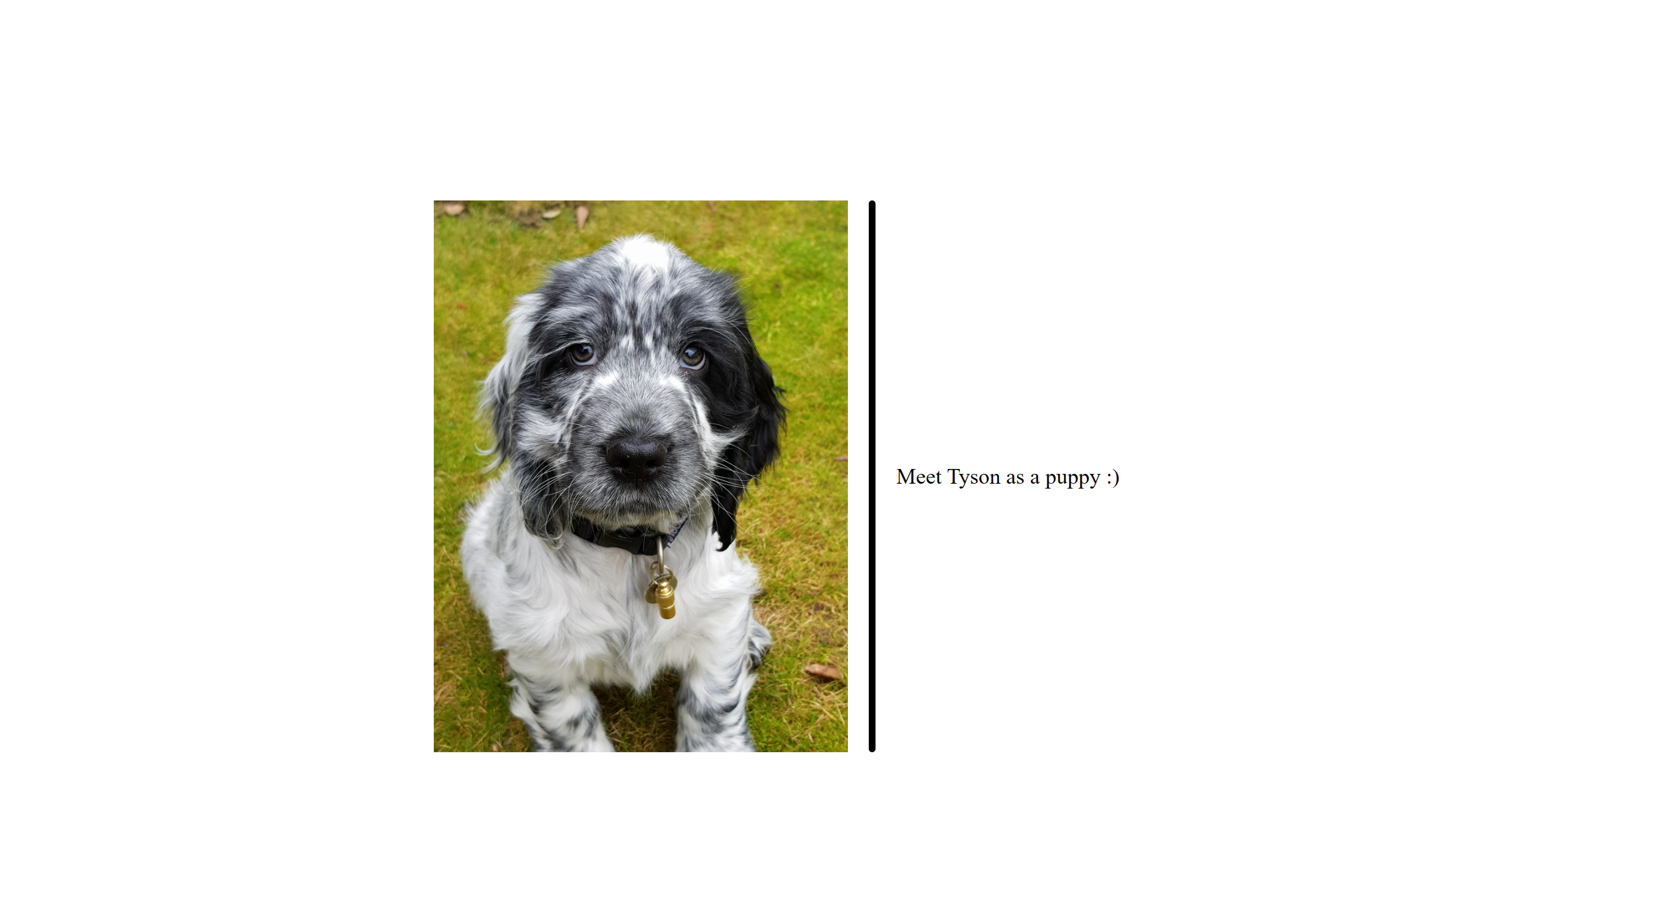
Flexbox example
CSS
row direction inner div / container
column direction outer div / container
Notes:
See tyson-exercise (I have a solution there for you)

Slide 33
Flexbox example
CSS
Notes:
See tyson-exercise (I have a solution there for you)

Slide 34
03
Javascript
It’s getting lively

Slide 35
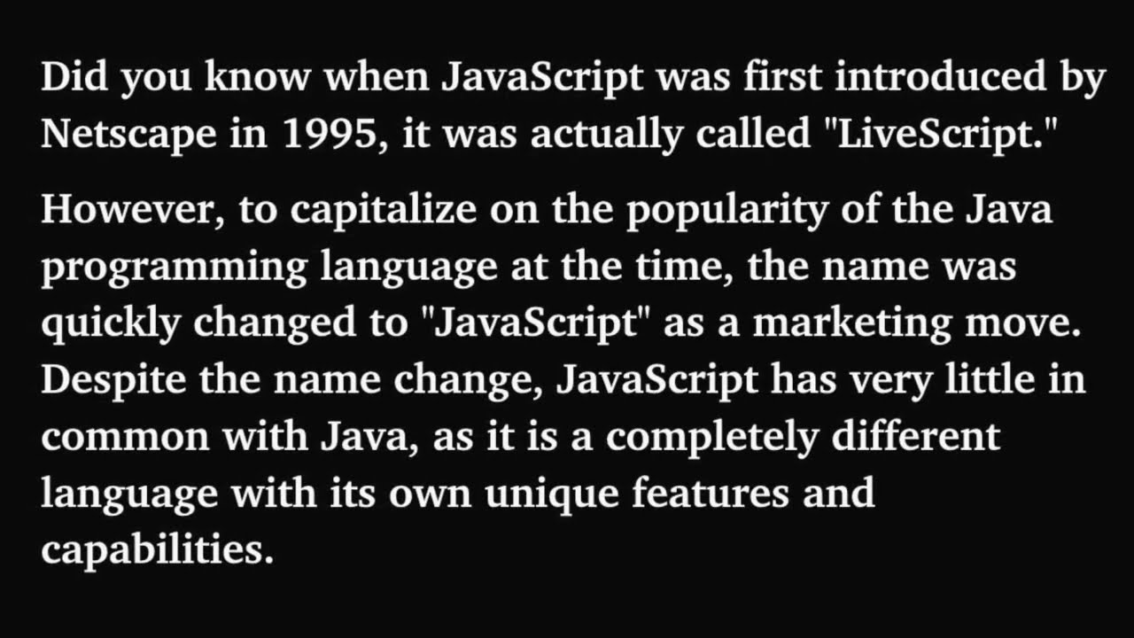
Javascript
JavaScript
Notes:
How did Javascript's name come by? – YouTube, just copying quickly as in a rush

Slide 36
Javascript
JavaScript
Can write JavaScript within HTML script tags, or again, as preferred, in a separate file.
We write JavaScript in .js files.
You can include the via <script src=“…”></script>
It is best to include these at the end of the body – load the content first, the animations second (unless required).

Slide 37
Console.log
JavaScript
You can print like in other languages via console.log(…)
This will print output to the console in your browser.

Slide 38
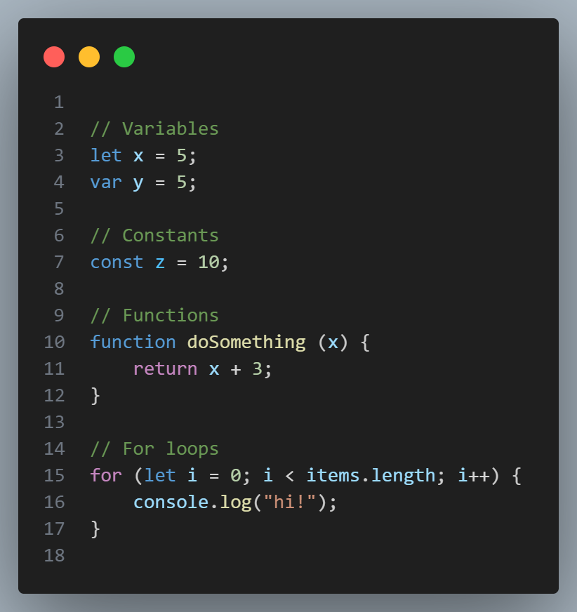
Basic JS
JavaScript
JS in many ways resembles a blend of C and Python syntax.
Curly braces are back. For loop syntax is back. Types are not. (See typescript!)

Slide 39
Basic JS
JavaScript
Javascript allows us to manipulate the DOM. To do so, we need to get DOM objects:
.getElementById document.getElementById(‘main-p’)
.querySelector document.querySelector(‘.item’)
.querySelectorAll document.querySelectorAll(‘.item’)
.parentElement
button.parentElement

Slide 40
Basic JS
JavaScript
Javascript also allows us to manipulate the DOM:
.createElement
let p = document.createElement(‘p’);
.innerHTML
p.innerHTML(‘New paragraph!’);
.style
p.style.backgroundColor = “green”;

Slide 41
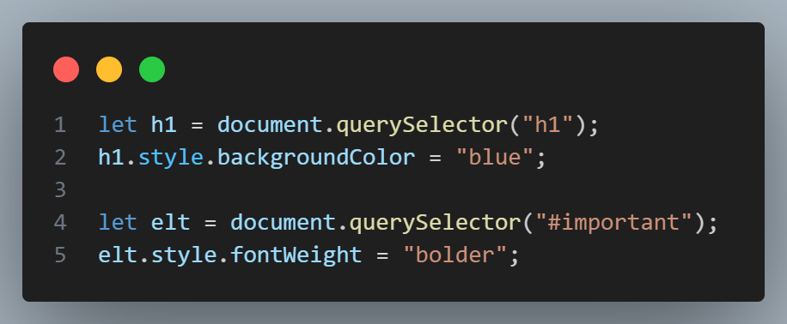
Basic JS
JavaScript
Variables represent actual objects on the DOM/things on the page!

Slide 42
Event listeners
JavaScript
<DOM_ELT>. addEventListener(<event>, <fun>)
This creates an ‘event listener’ attached to this DOM element, every time <event> is detected at this element, it executes <fun>.
button.addEventListener(‘click’,
function() {alert(‘clicked!’)})

Slide 43
Anonymous functions
JavaScript
button.addEventListener(‘click’, function() {alert(‘clicked!’)})
function handleAlert() {
alert(“Loaded!");
}
document.addEventListener(‘DOMContentLoaded’, handleAlert);

Slide 44
04
PSET
Trivia time

Slide 45


PSETs
PSET
Let’s work on the Trivia problem set together!

